Slide 1


Games and Artificial Intelligence Techniques
Assignment 2
Sumanjit Kaur
S3819846

Slide 2
Objectives
Game setup
Python Setup
ML-Type (Reinforcement Learning and Imitation Learning)
Use Of A* Algorithm
Agents Training
Training Graphs on Tenserflow

Slide 3
Setup
Game
Demonstration of Machine Learning with unity3d-ML.
Combination of both ML techniques supported by Unity along with A* path finding Algorithm.
Python
Libraries - PyTorch and Cuda
Virtual environment for installing ML agents library from unity package manager

Slide 4
What and Why
Imitation and Reinforcement Learning
For the purpose of training of agents.
It creates a task book and give it to ML-agents and tell it to perform all of them in serialized manner.
For creating a task list, we need to play the game many times and record all the steps.
By using reinforcement technique ml-agent try to copy task list to achieve the goal.
For best training, positive rewards to ml-agents if it does nicely and negatively if not.

Slide 5
In reinforcement learning, every time ml-agents process old reward data and on behalf of that calculation, it takes decision for its next step.
Raycasting
Used for giving observations and where to go or where not to go.

Slide 6
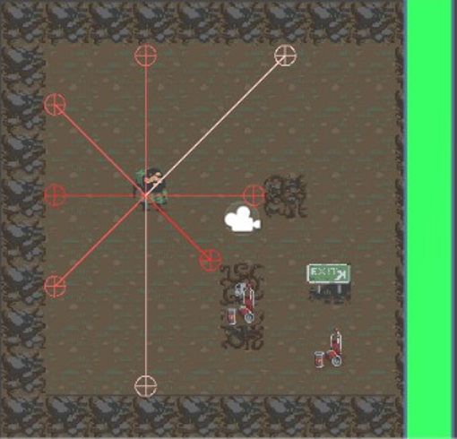

Slide 7
Use of A* Algorithm
Used for creating task list or playing demo for ml-agents
Can be called it Lets Unity-AI teach Unity-ML agents
Utilised at the time of agents training with imitation training.
The board is scanned by using A* Algorithm and give a target to it
Then, start the game and it automatically find the path to reach to the target in between obstacles.
After running the game multiple times, the data is fed to imitation learning.

Slide 8
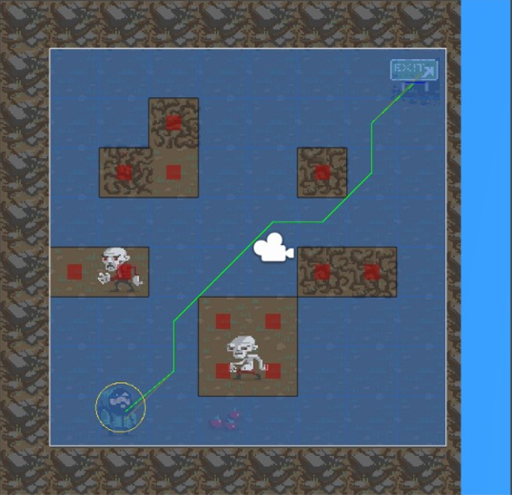
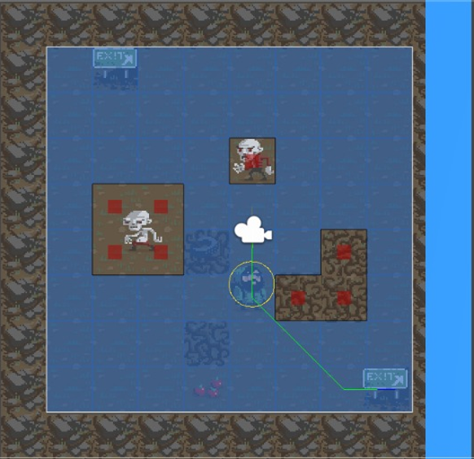

Slide 9
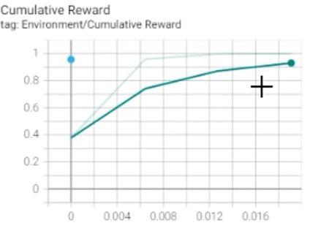
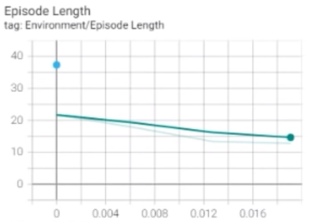
Training graph in TensorFlow

Slide 10
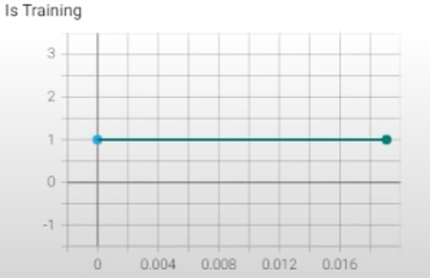

Slide 11
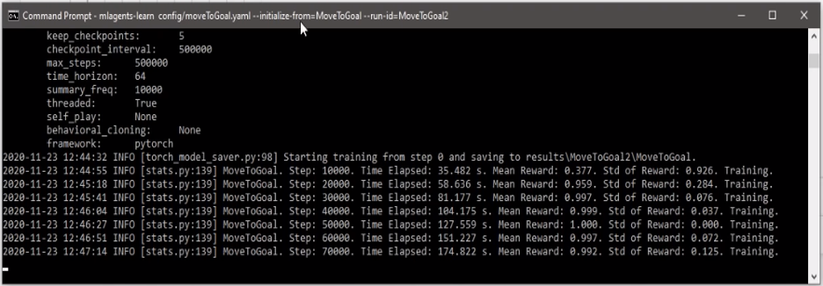

Slide 12
Conclusion
It is proved that Unity has very high level machine learning algorithm that is very efficient to do all the ML-related work
It is found that we can create more complex system to work with ML-agents.
This project teaches how to use Reinforcement and Imitation Learning in Unity to create games and work with Machine Learning.

